Slide 1
Futsal Field Reservation System
Developed By:
Ehtisham Naveed
CK-FA-21-110734
Saadullah
CK-FA-21-110420
Supervised By:
Mam Nazish Bashir
Program:
Computer Science
Session:
Fall 2021 to Spring 2025
Department of Computing & Technology
Iqra University Islamabad Campus (Chak Shahzad)

Slide 2
Contents
Introduction
Problem description
Proposed Solution
Aims and Objectives
Methodology
Modules
Tools & Technologies
Prototype
Code snippet
Limitations
Future Work
Question Answer session

Slide 3
Introduction
In Pakistan, especially in cities like Rawalpindi and Islamabad, there is no proper online system to help football players book futsal grounds. Players usually waste time calling different ground owners, and ground owners also wait for random calls to get bookings, which is not efficient.
Our project, Futsal Field Reservation System is a web-based platform that helps both players and ground owners. It allows players to view available time slots and book grounds easily.
Ground owners can manage their schedules and bookings from one place. The system also lets teams communicate, join academies, and support poor players through donations.

Slide 4
Problem Description
Currently, there is no proper system in Pakistan that helps local football players book futsal grounds easily. Players have to contact ground owners one by one to ask if any time slots are available, which is a very time-consuming and frustrating process.
On the other side, ground owners wait for people to call them, which is not good for their business and causes delays in bookings. Even after finding a free ground, players still face difficulty in finding other teams to play against.
These problems make it harder for football lovers to enjoy the game and limit the growth of local sports activities.

Slide 5
Proposed Solution
The Futsal Field Reservation System to solve these problems. Through this system, players can easily check which futsal grounds have available time slots no need to call anyone.
Teams can also chat with each other directly on the platform to plan and schedule matches. It saves time and makes coordination simple and quick.
Ground owners will be able to manage their bookings, update their schedules, and attract more customers. This system connects the football community and helps grow local sports in a smart way.

Slide 6
Aims and Objectives
Aim: To make it easy for football teams to book futsal grounds online. To help grounds owners manage booking without phone call or manual work.The system helps build a better, more organized, and supportive sports community for everyone.
Objectives:
1. To Develop a website for booking Futsal grounds easily.
2. To promote Football culture in twin cities.
3. To let grounds owners register and manage their Facilities online.
4. To make the booking process fast, digital and simple.
5. To allow Teams and Owners to chat for match planning.
6. Include an AI-powered “Futsal Assistant” to quickly answer questions and
provide help.

Slide 7
Literature Review
1. Ptichbooking (UK):
This is a UK website for booking sports fields, like for football and tennis. It is easy to use and shows when fields are free. It helps owners manage their grounds. However, it does not have community features like finding other teams, signing up for training, or a donation option.
2. Gwsports (India):
Gwsports is a website in India that helps players find grounds for sports like cricket and football. It is useful for finding places to play and organizing events. However, it does not have a chat feature for teams to communicate with each other. It also lacks a donation option to support players in need.

Slide 8
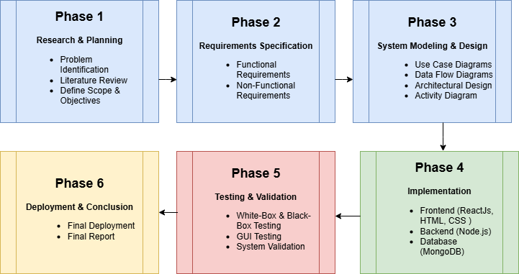
Methodology

Slide 9
Modules
Module 1 (User Module): Football players can register, login, and book grounds.
Module 2 (Ground Owner Module): Owners can add grounds, manage slots, and accept bookings.
Module 3 (Reservation Module):Manages all ground booking and availability checking.
Module 4 (Academy Module): Lets users register for football coaching or academies.
Module 5 (Donation Module): Accepts donations and helps players who need financial support.
Module 6 (Communication Module): Allows chat between users, teams, and ground owners.
Module 7 (AI Chat Assistant Module): Helps users with booking, schedule info, FAQs, and general queries using an AI chatbot.

Slide 10
Tools & Technologies
Frontend:
ReactJS :For building a fast and interactive user interface.
HTML, CSS, JavaScript : Core web technologies for styling and structure.
Backend:
NodeJS : Server-side logic and API handling.
ExpressJS : Lightweight web framework for building APIs.
Database:
NoSQL (MongoDB) : For storing user data, bookings, messages, etc.
Api’s:
Gemini API( AI Futsal Assistant)
Location IQ ( OpenMapStreet)

Slide 11
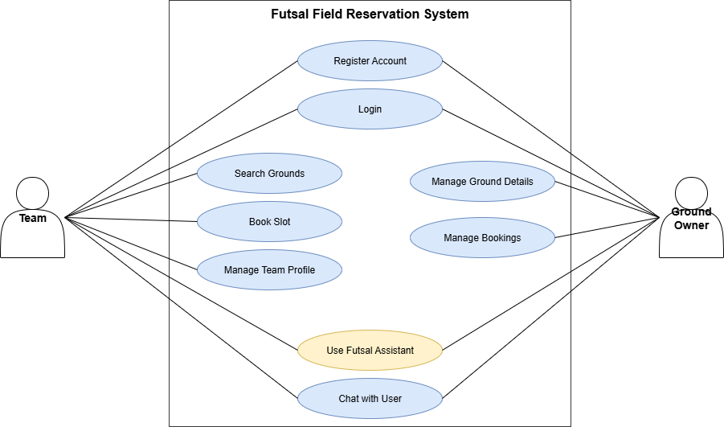
Use Case Diagram
.

Slide 12
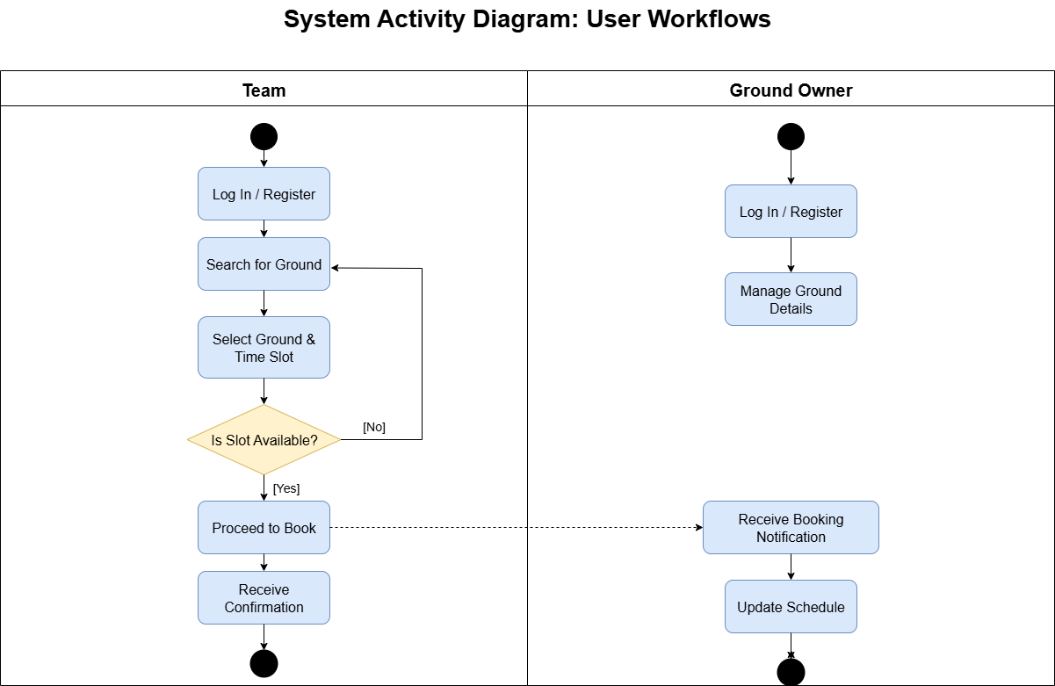
Activity Diagram

Slide 13
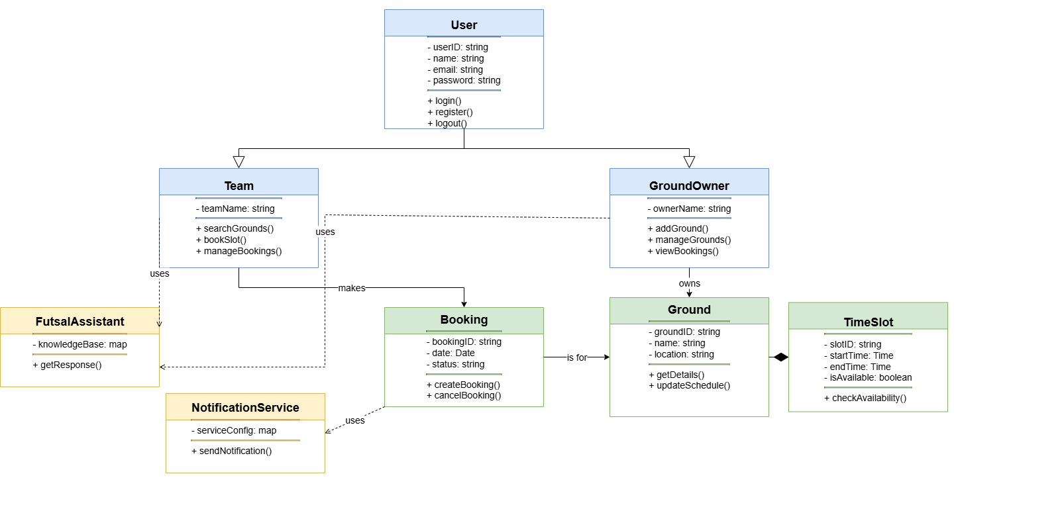
Class Diagram
.

Slide 14
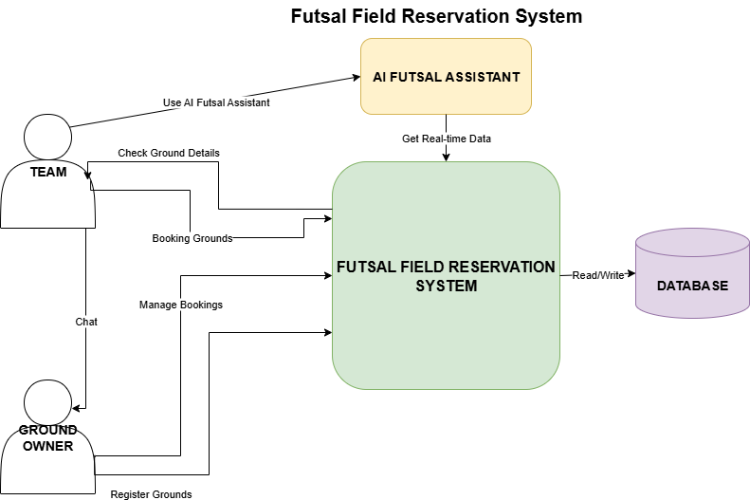
Data Flow Diagram
.

Slide 15
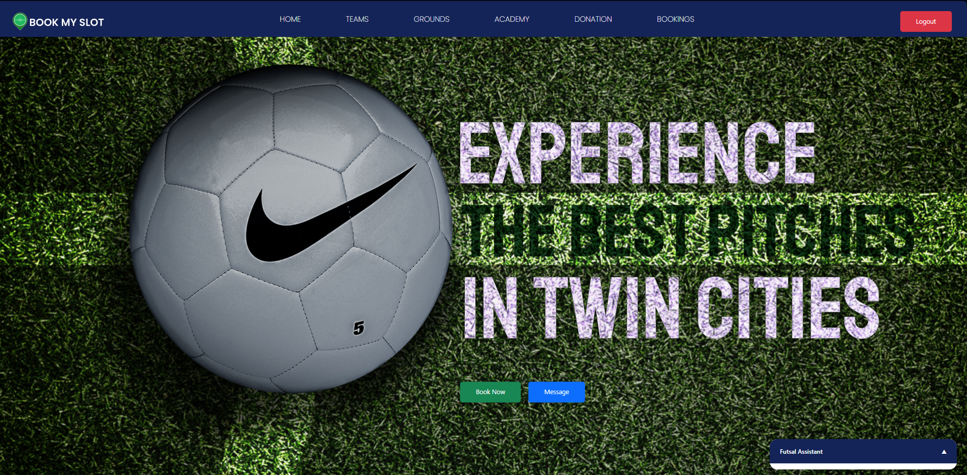
Prototypes
Dashboard:

Slide 16
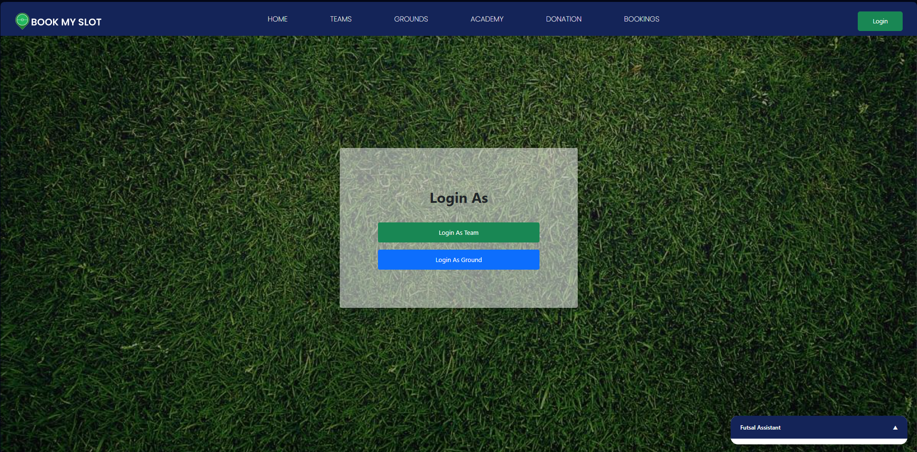
Login/Signup(Team Owner/Ground Owner

Slide 17
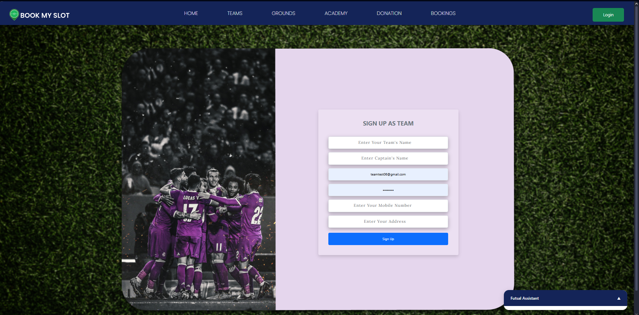
Signup as a Team Owner

Slide 18
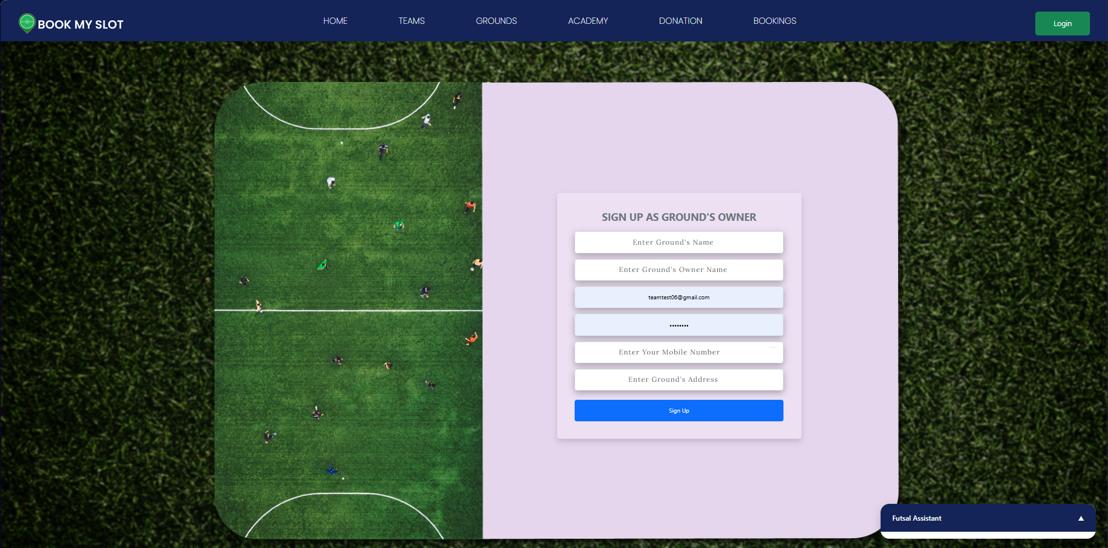
Signup as a Ground Owner

Slide 19
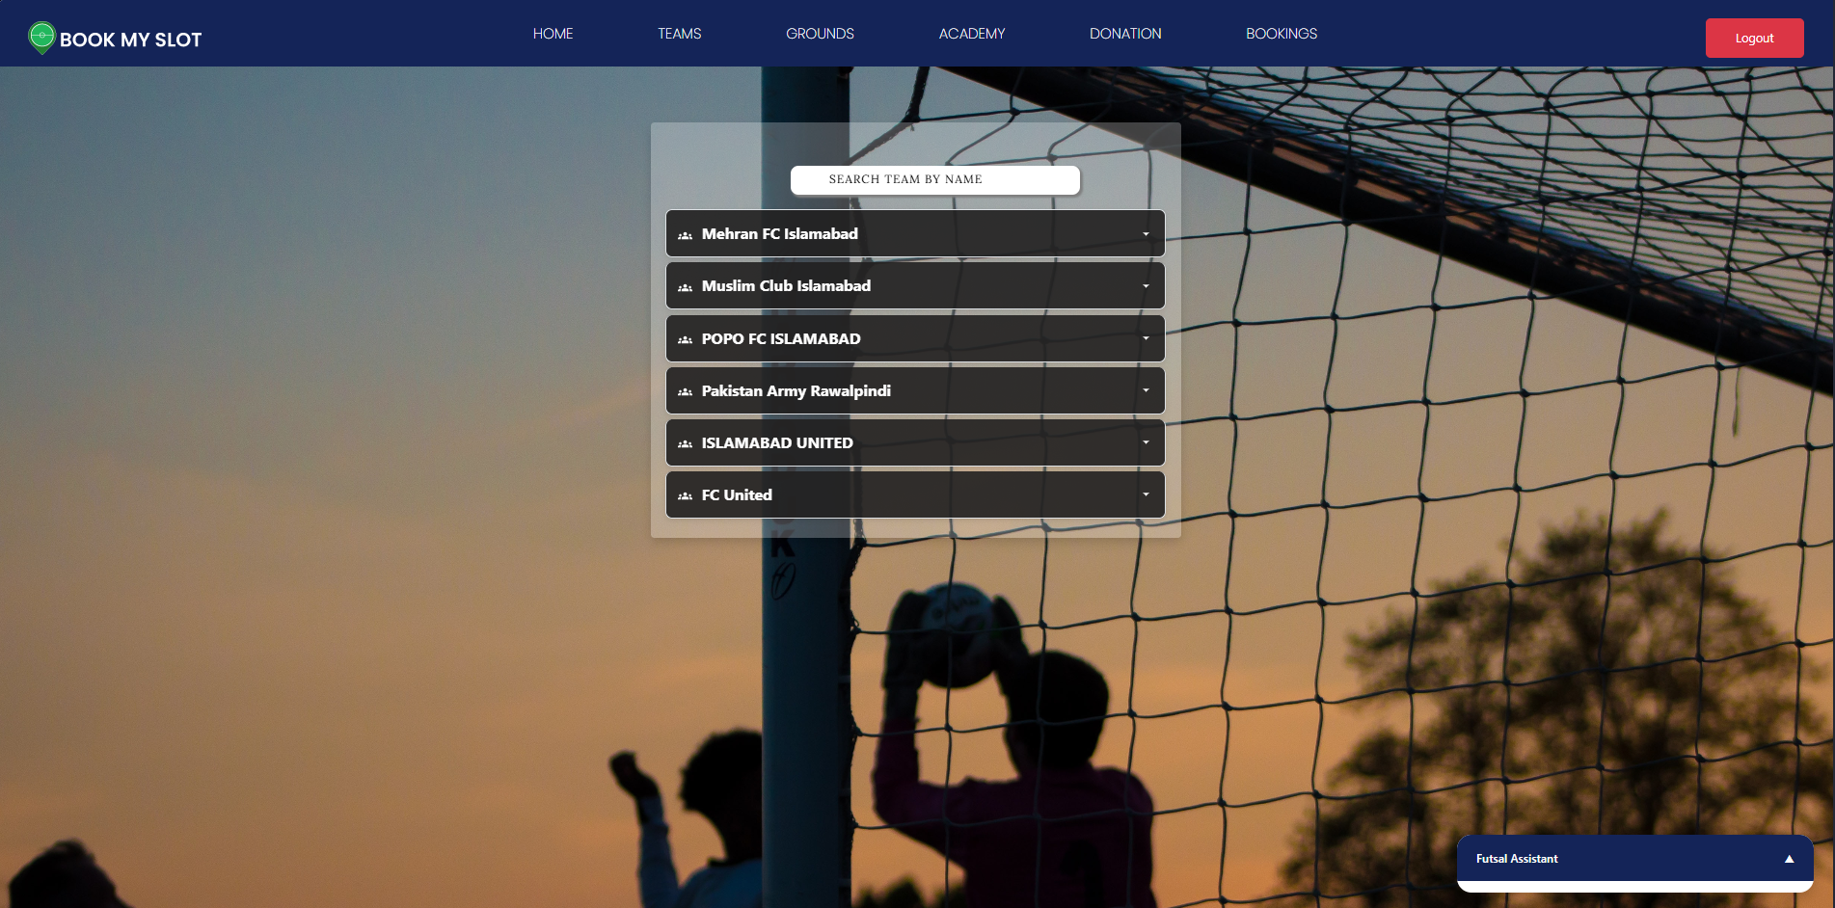
Teams Dashboard

Slide 20
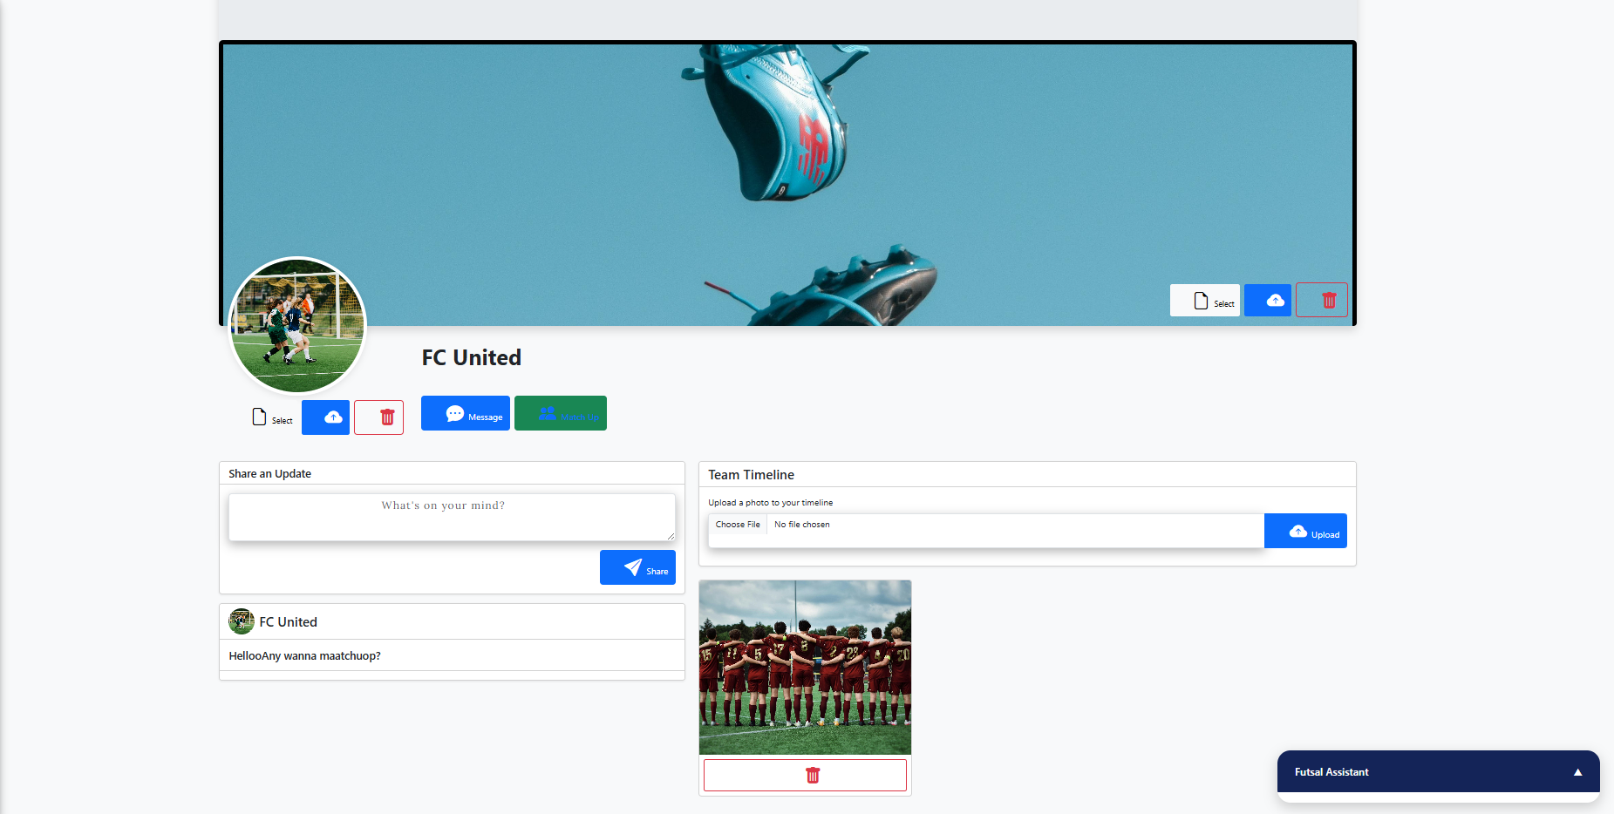
Teams Profile Dashboard

Slide 21
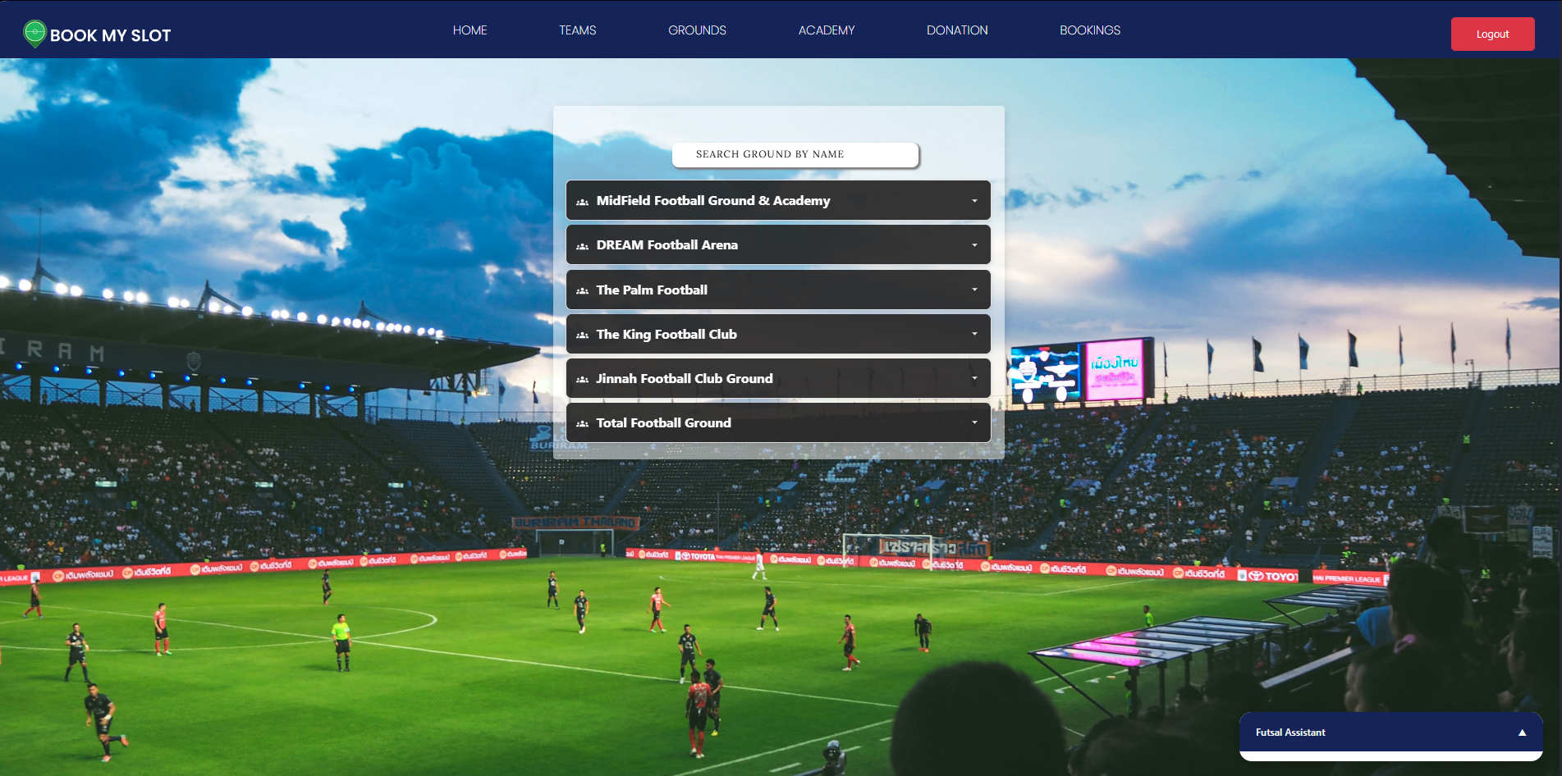
Ground Dashboard

Slide 22
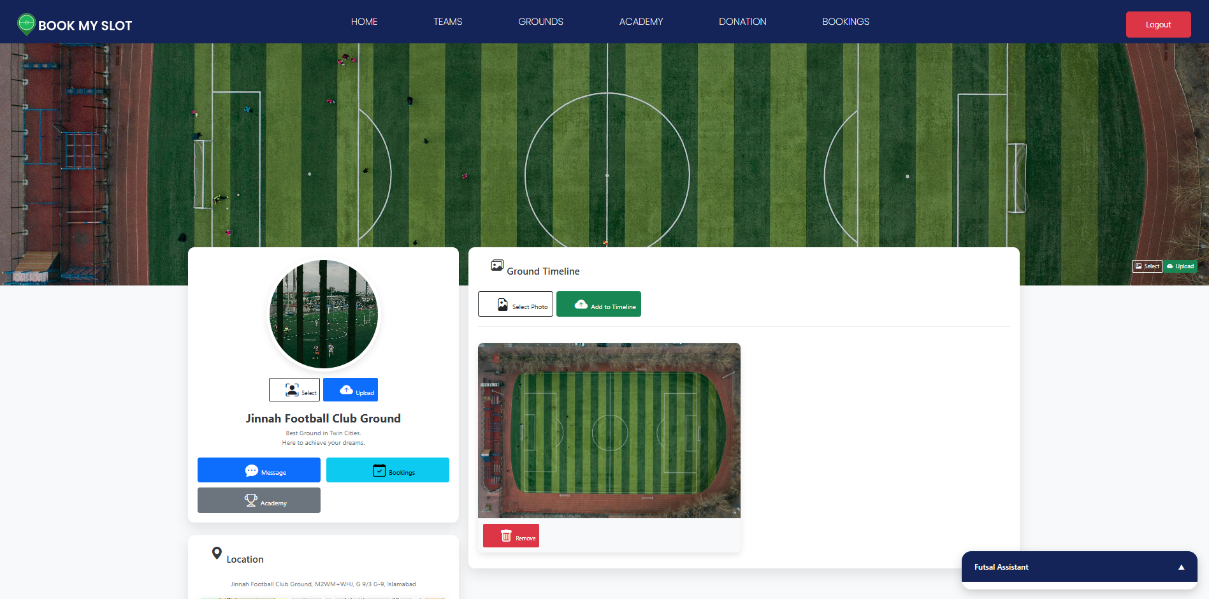
Grounds Profile Dashboard

Slide 23
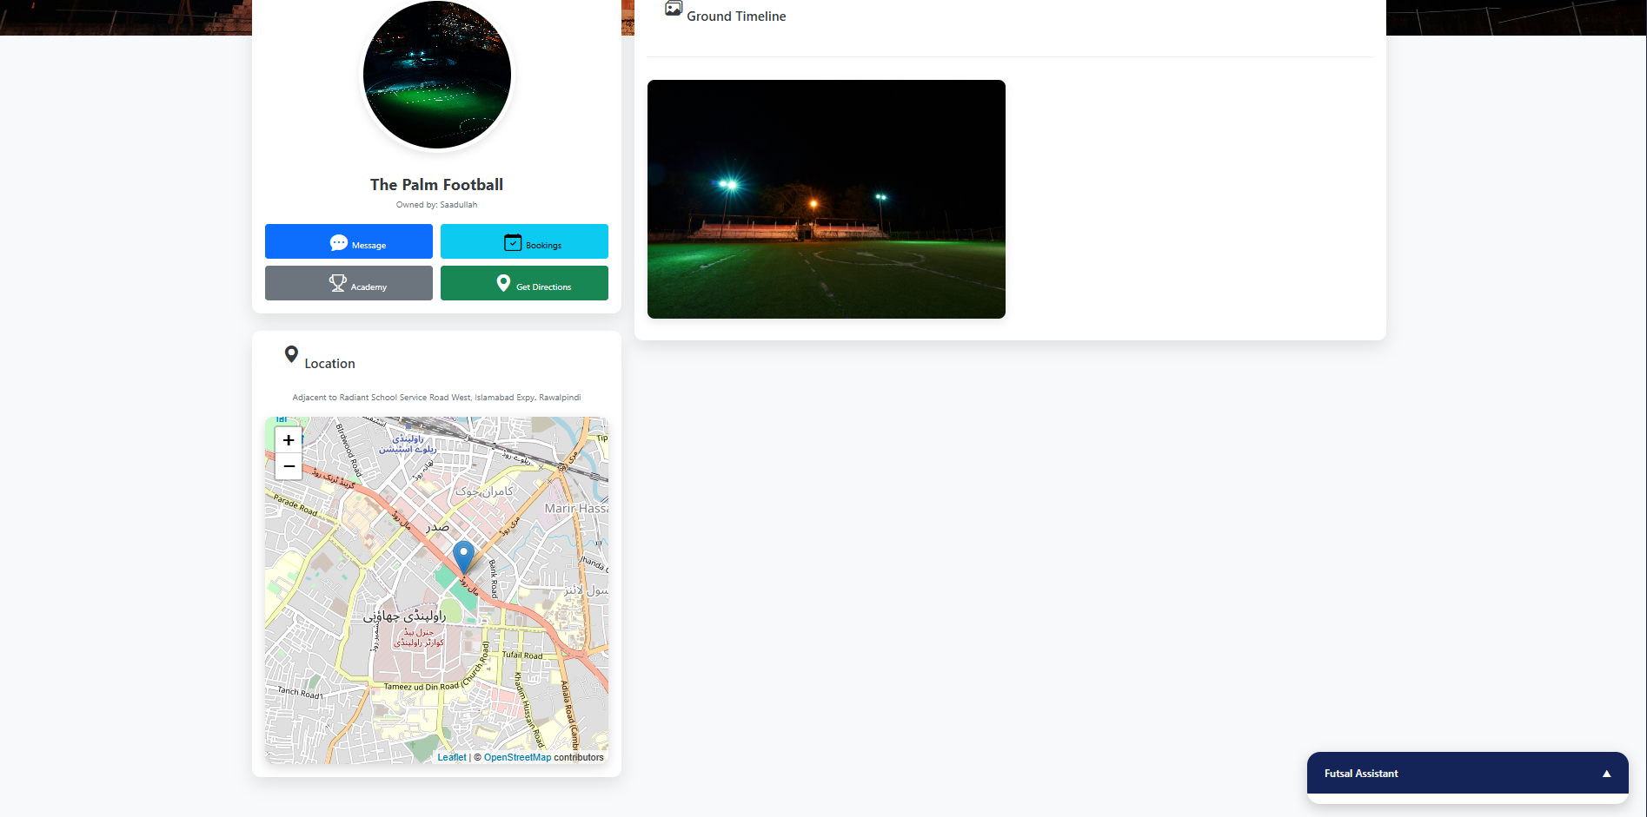
Ground Location

Slide 24
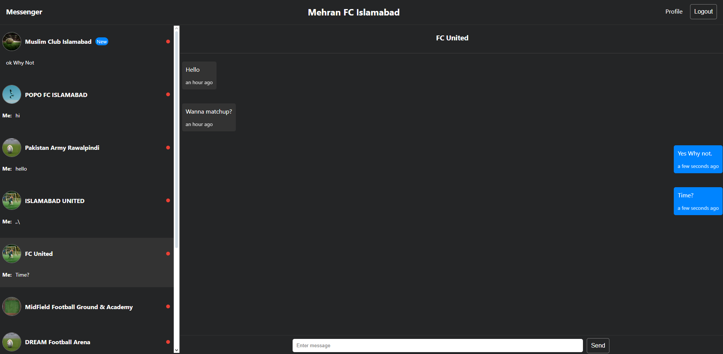
Chat Box (Messenger)

Slide 25
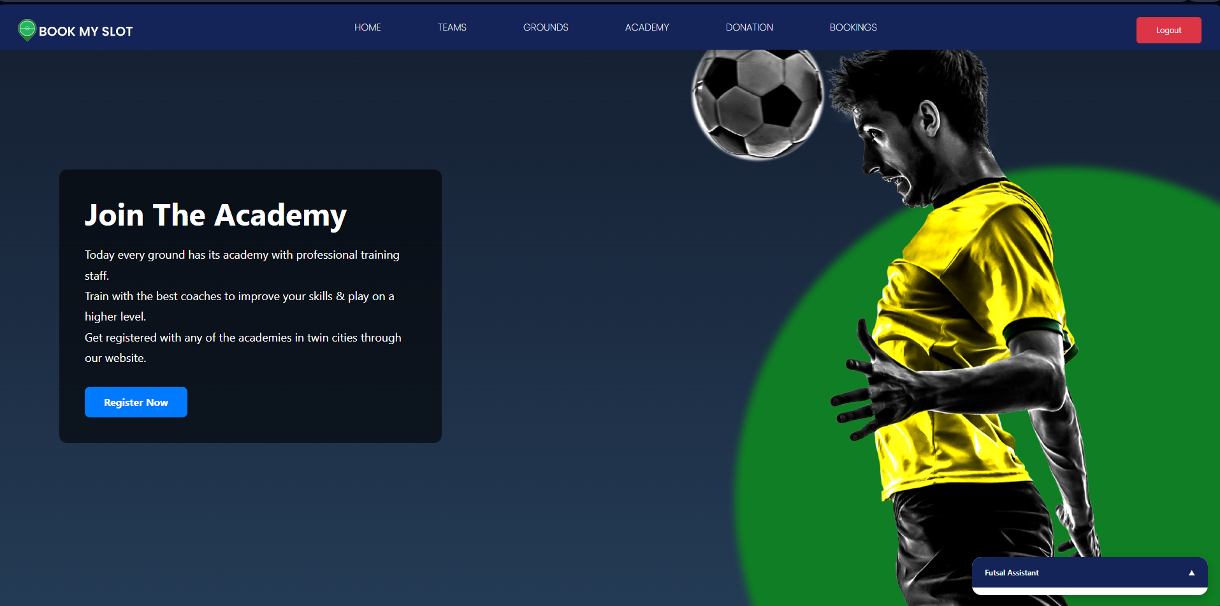
Academy Dashboard

Slide 26
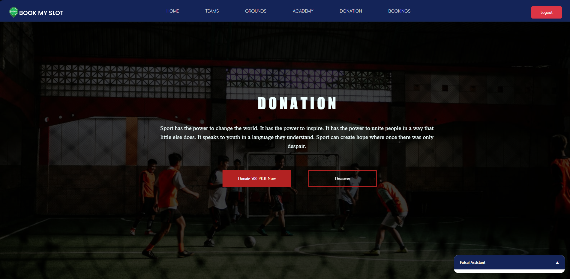
Donation Dashboard

Slide 27
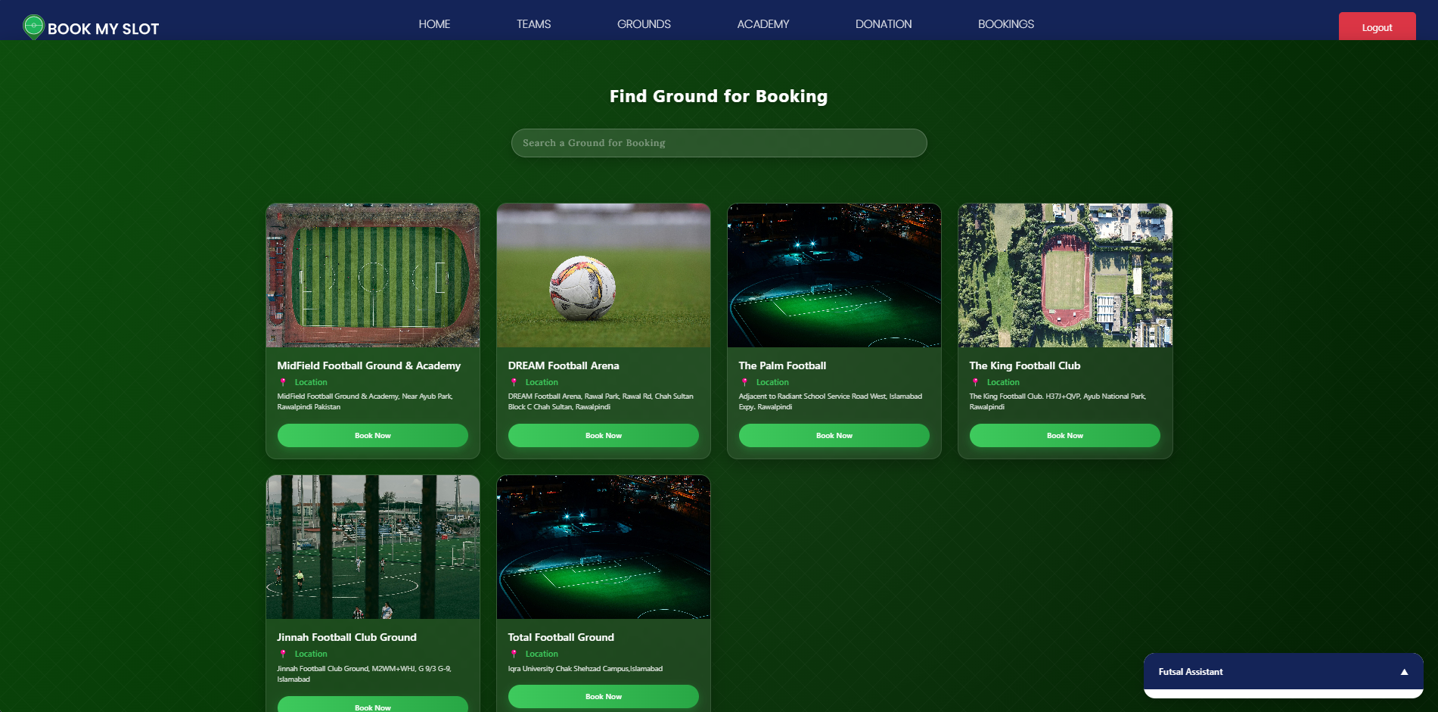
Booking Dashboard

Slide 28
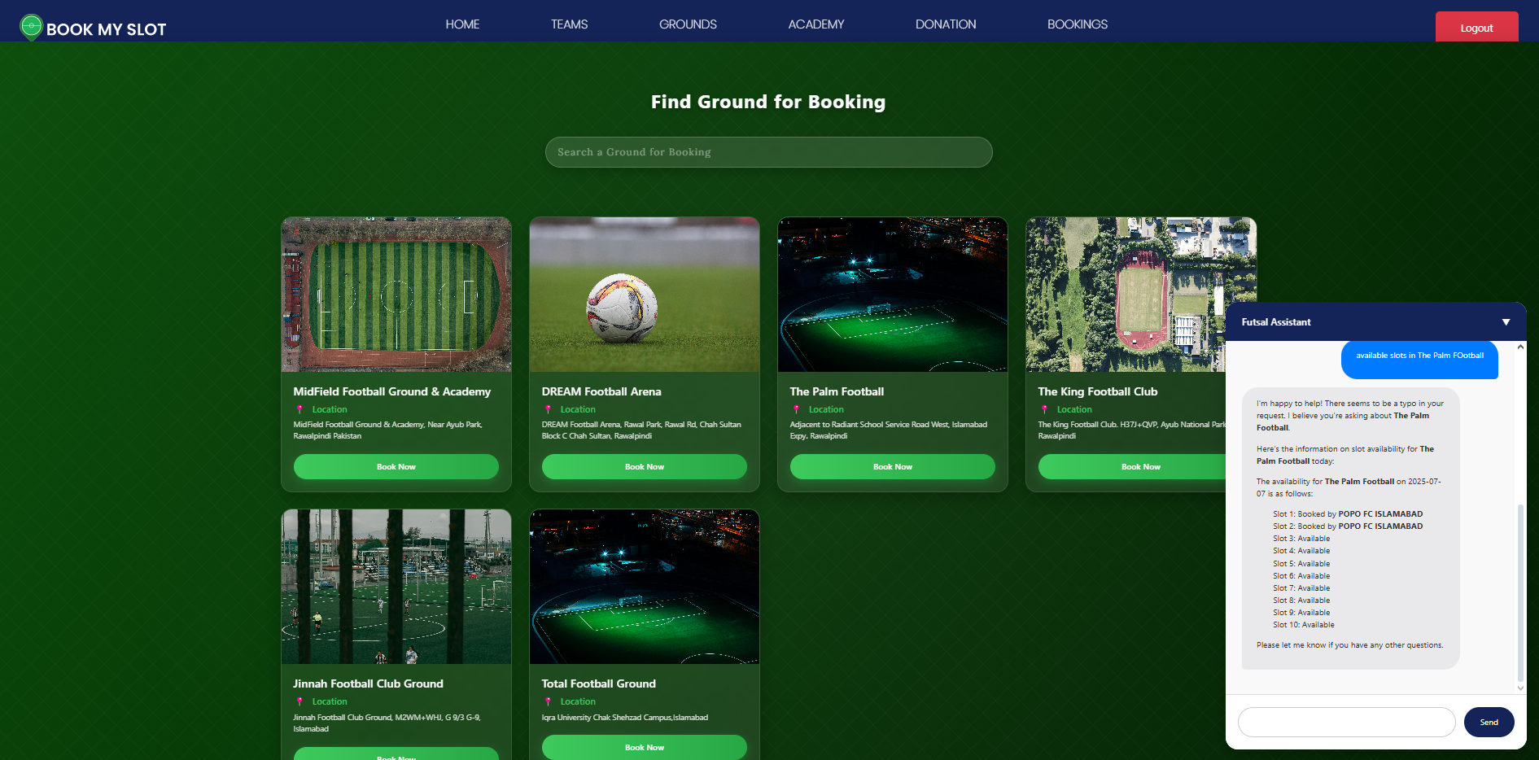
Ai Chat Box (Futsal Assistant)

Slide 29
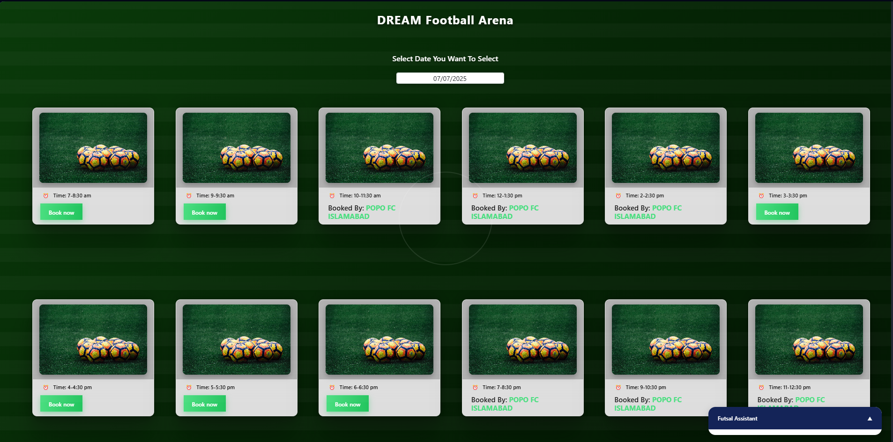
Available/Booked Slots Dashboard

Slide 30
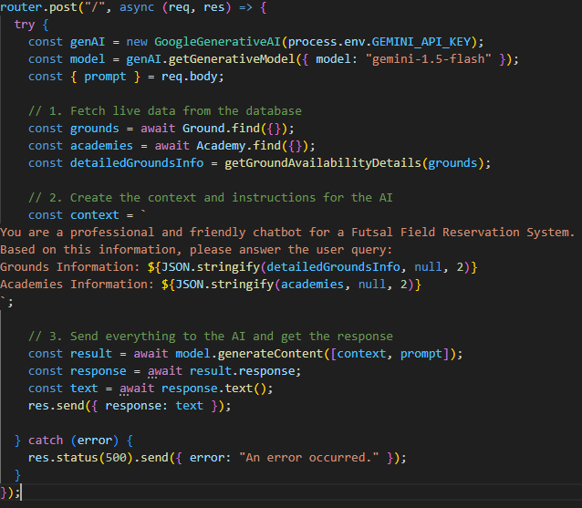
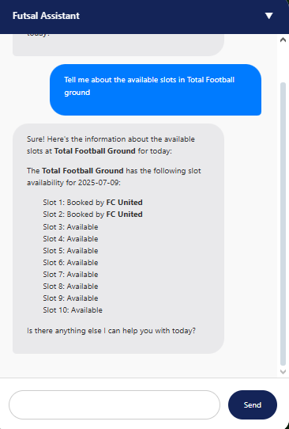
Code Snippet(Ai Chatbot)

Slide 31
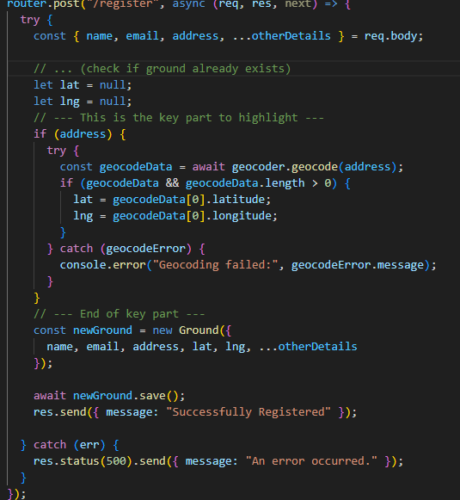
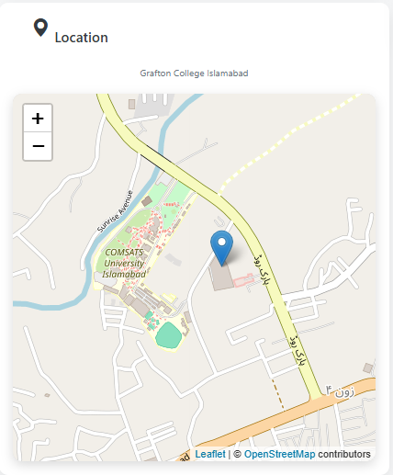
Code Snippet (Ground Registration with Geaocoding)

Slide 32
Limitations
Internet Required: The system works only online no internet, no booking.
No Mobile App (Yet): It’s a web-based system only. Not available as an Android/iOS app yet.
Limited to Twin Cities: Currently designed just for Islamabad and Rawalpindi not available in other cities.

Slide 33
Future Work
Mobile App Version: Create an Android and iOS app to make booking easier for mobile users.
Team Ranking System: Add team stats and rankings based on matches played and won.
Online payments Integration: Add payment options like JazzCash, EasyPaisa, and credit cards for booking.
Live Score & Highlights:Let teams update scores during the match or upload short videos.

Slide 34
Conclusion
Successfully created a website that solves the problem of booking futsal grounds in the twin cities. It provides an easy-to-use platform for both football teams to find games and for ground owners to manage their schedules. This makes the whole process simpler and better for the entire local sports community.

Slide 35
Any Questions?

Slide 36
THANK YOU

